Slide 1
Transform Products & Services with IoT
Building The Foundation

Slide 2

Raspberry Pi 3 / IoT Gateway
1.2GHz 64-bit quad-core ARMv8 CPU
1 GB RAM
802.11n Wireless LAN
Bluetooth 4.1 / Bluetooth Low Energy
4 USB ports
40 GPIO pins
Full HDMI port
Ethernet port
3.5mm audio jack
Camera interface (CSI)
Display interface (DSI)
Micro SD card
VideoCore IV 3D graphics core
$35 US
www.raspberrypi.org
Notes:
Functions a decent desktop computer with a graphical UI.
Also serves as a great IoT gateway.
Designed for learning and experimentation.
Access to I/O pins facilitates easy integration of devices and sensors.
One such device is….

Slide 3
Sense Hat / IoT Device
The Sense HAT is a sensor board packed with sensors
8x8 RGB LED matrix
five-button joystick
gyroscope
accelerometer
magnetometer
temperature
barometric pressure
humidity
The Sense HAT is the hardware used in the Astro Pi mission on the International Space Station.
Notes:
Everyone at the table gets a Raspberry Pi, a Sense hat, and a 16GB microSD to take home with them for further learning.
Only one Pi per team, the one already open and assembled will be used for the labs.
The assembled Pi belongs to the designated team leader (wearing the distinctive BLUE lanyard).
As such, they will be responsible for securing it in the evening and bringing it back tomorrow.
Visit the burn zone to have the Raspberry Pi OS (raspbian linux) burned on to your microSD. As well as any questions you might have.

Slide 4





Transform Products & Services with Intelligent Connected Devices
PUBLIC NETWORK
CLOUD NETWORK
BLUEMIX SERVICES
PRIVATE NETWORK
Raspberry Pi with SenseHat
Browser/nodeRED UI
(Web Client Dashboard)
Node-RED
DashDB
CLOUDANT
NOSQL DB
IoT Platform

Slide 5
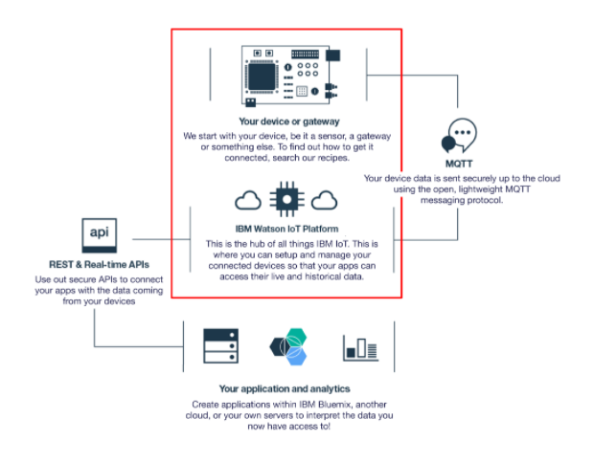
Transform Products & Services with Intelligent Connected Devices

Slide 6

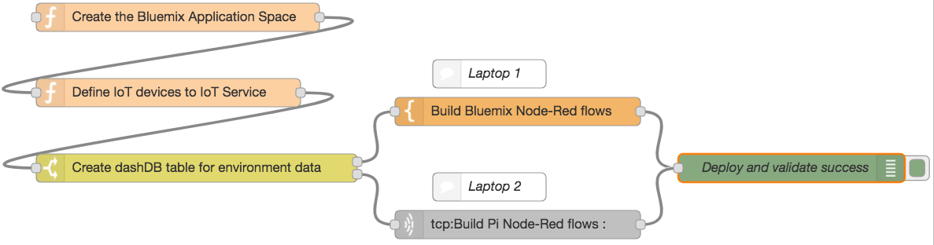
The Path of the Jedi
Notes:
Explain the flow
Mention the optional split development purpose.
Prior testing and execution in Europe indicates approximately 1.5 - 2 hours to complete.
Will announce at approximately 40 minutes remaining that you may want to consider concurrent development.

Slide 7
The Jedi Code
At your table, printed instructions are. Also online at https://ibm.biz/Bdi6ik they are.
Choose your path, you must. If prior experience you have, follow the Master path. If a more guided approach you require, choose the Padowan path. Yes, hmmm.
Work in teams of three, you will. Cooperate, you must.
A number that matches the team number on your badge, each Raspberry Pi has.
Patience you must have, my young Padowan. Very agile, the Bluemix UI is.
Respect the bandwidth. Yeesssssss. To lab work limit network access.
Questions you have? Slack you should use. #stsa-workshop-faqs
Meet again at 5:10, we will. Herh herh herh.
Notes:
Master path basically describes the end requirements and you are left to get there.
In a very few places, you need to enter small snippets of code. Try and type them in rather than cut/paste.
Try to switch roles coder, documentation, debugger.
Slack channel relayed to big screen.
In addition to slack we have support throughout the room
Team Leaders,
Proctors,
Subject Matter Experts.
All can be summoned by raising the handy Yoda/Question sign at your table.
Lab takes roughly 1.5 – 2 hours
We will reconvene at 5:10
Incorporate breaks, manage your time.

Slide 8
Shutdown your Pi before you leave
Ctrl-C at tour node red terminal to get back to a command prompt
node-red-stop
sudo shutdown now
Green light next to red power light will flash a few times as system shuts down. (roughly 15-20 seconds)
Unplug the USB cable
Take your device with you each evening

